Slide 1


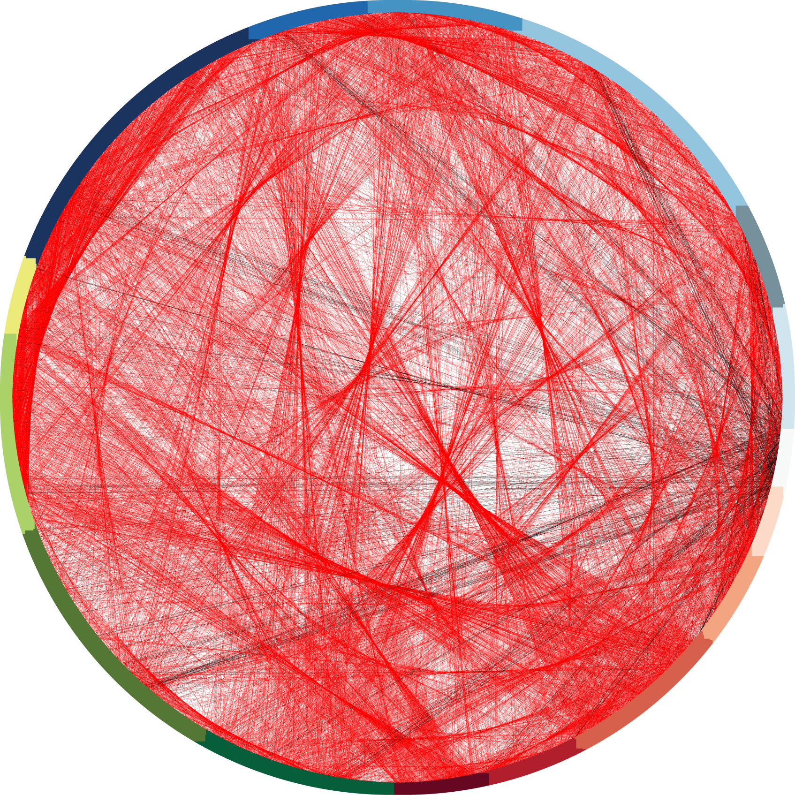
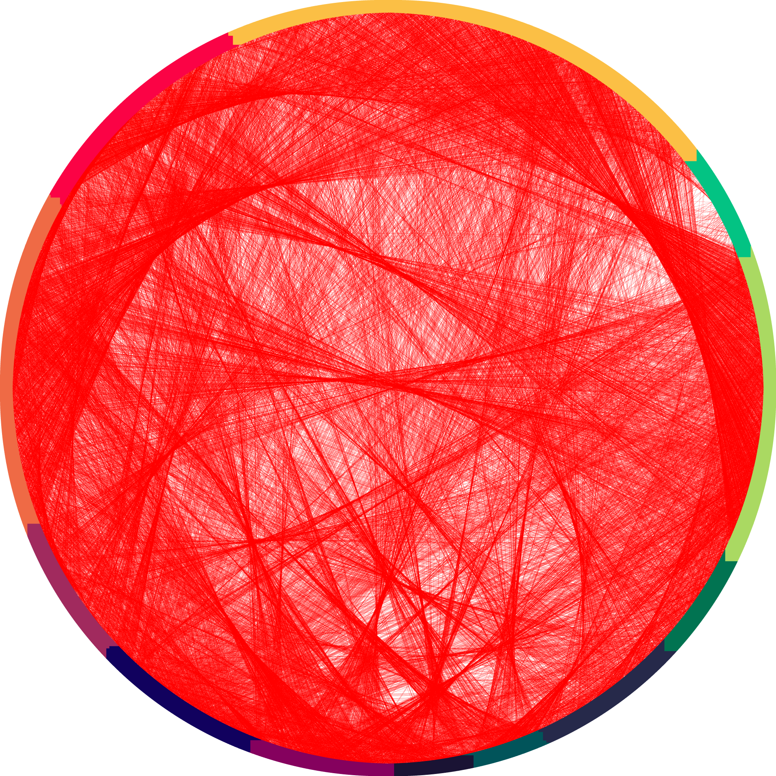
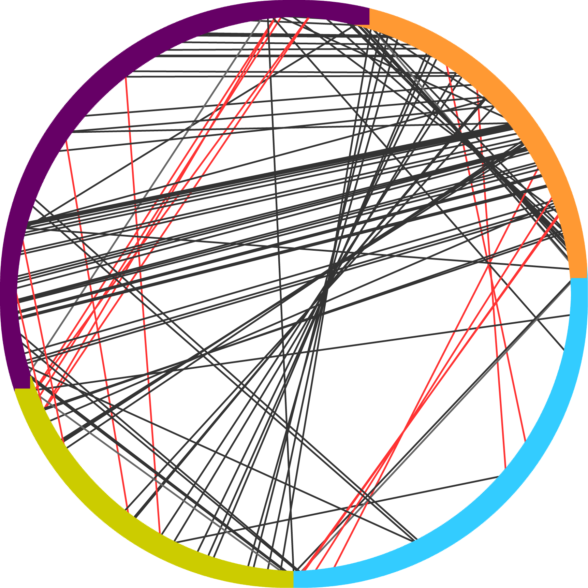
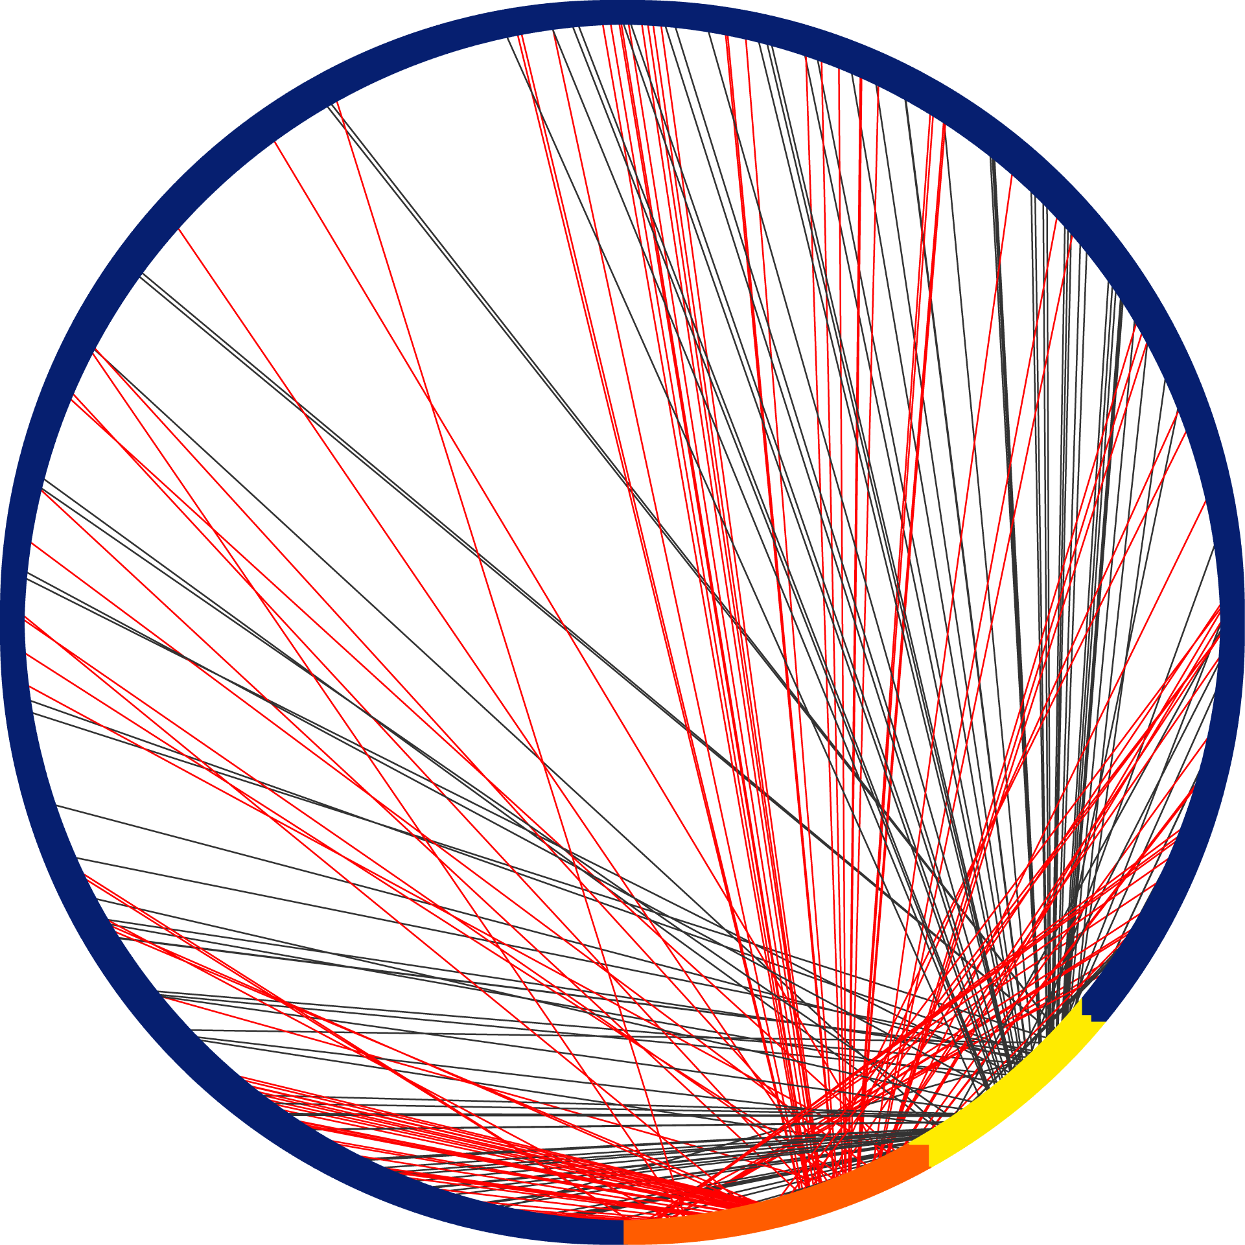
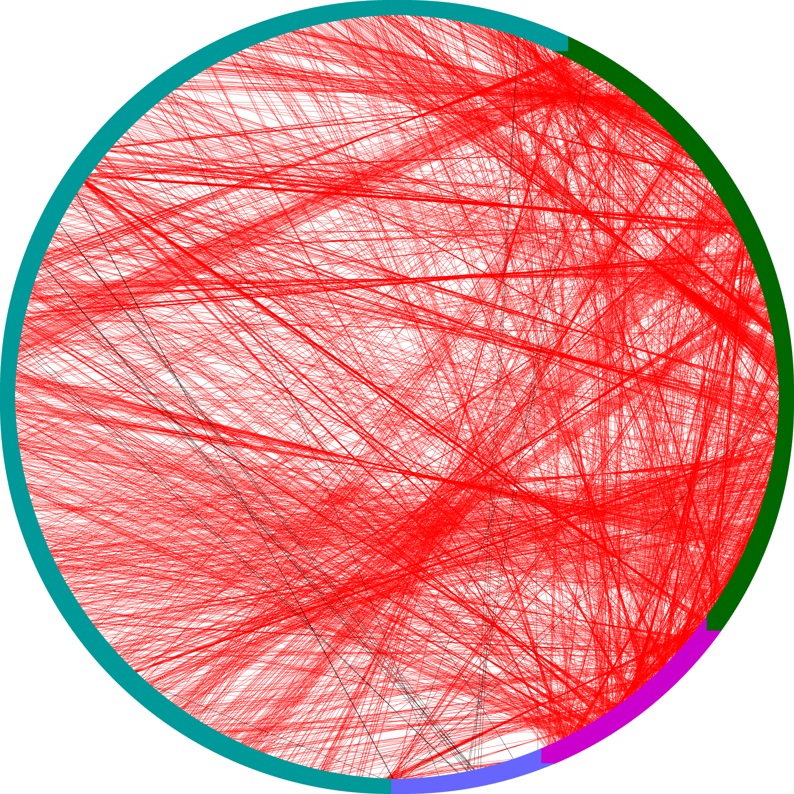
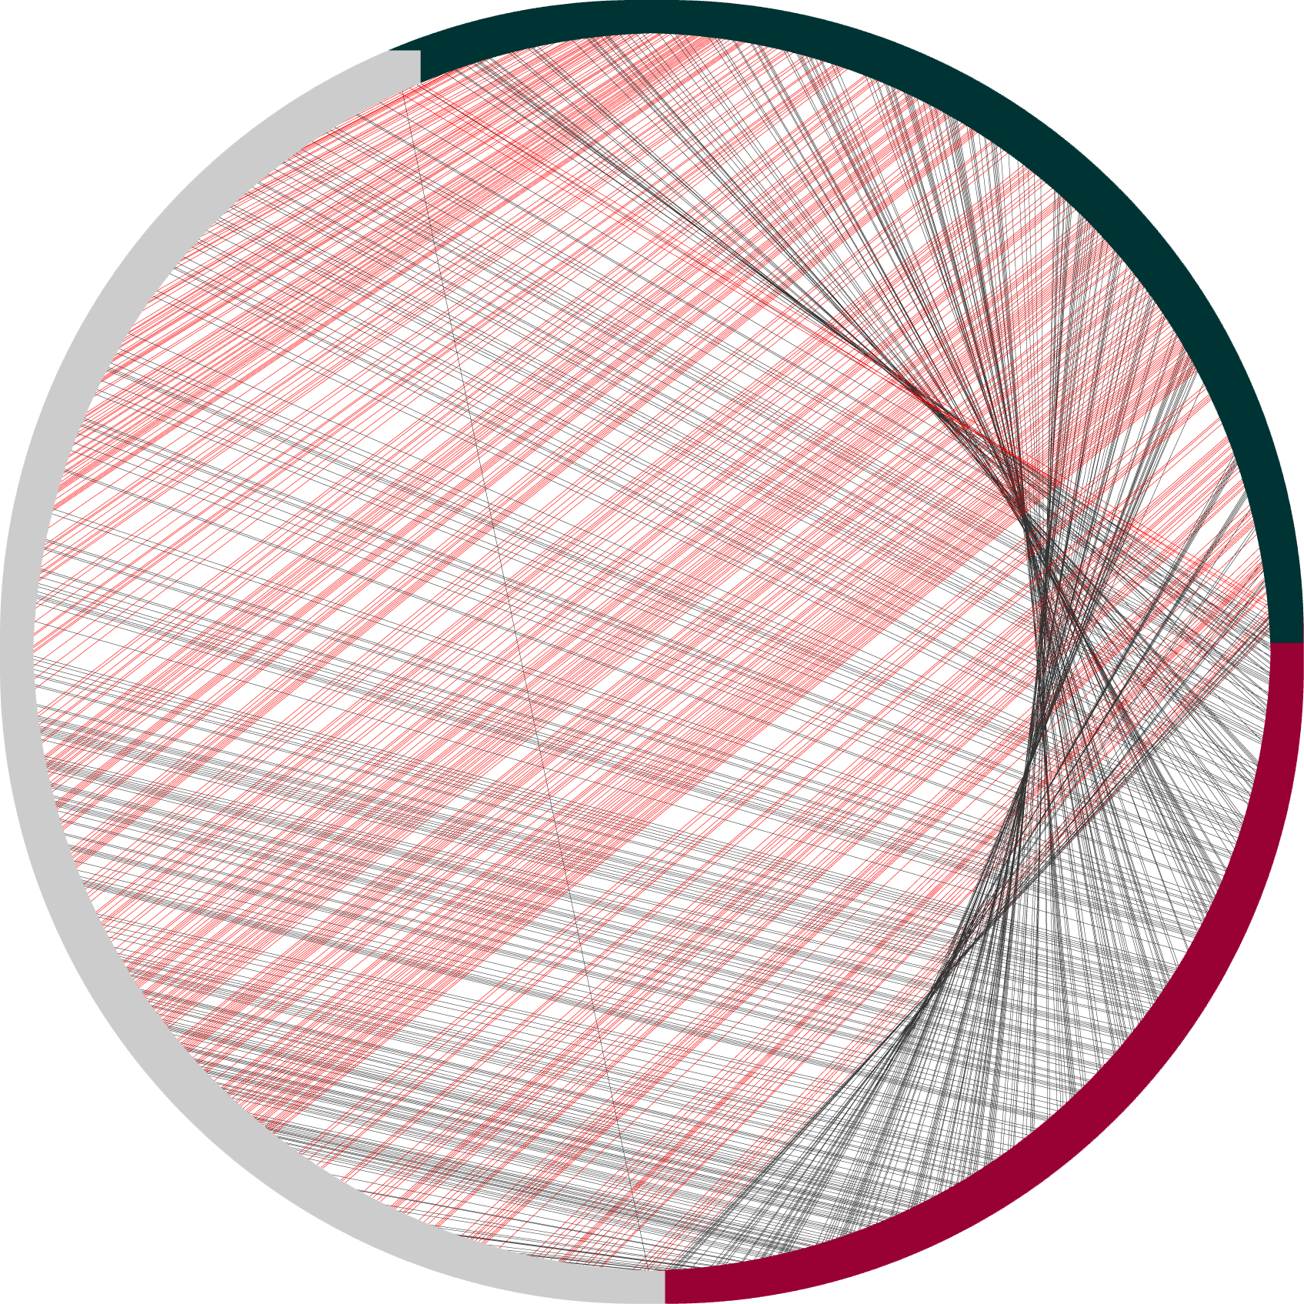
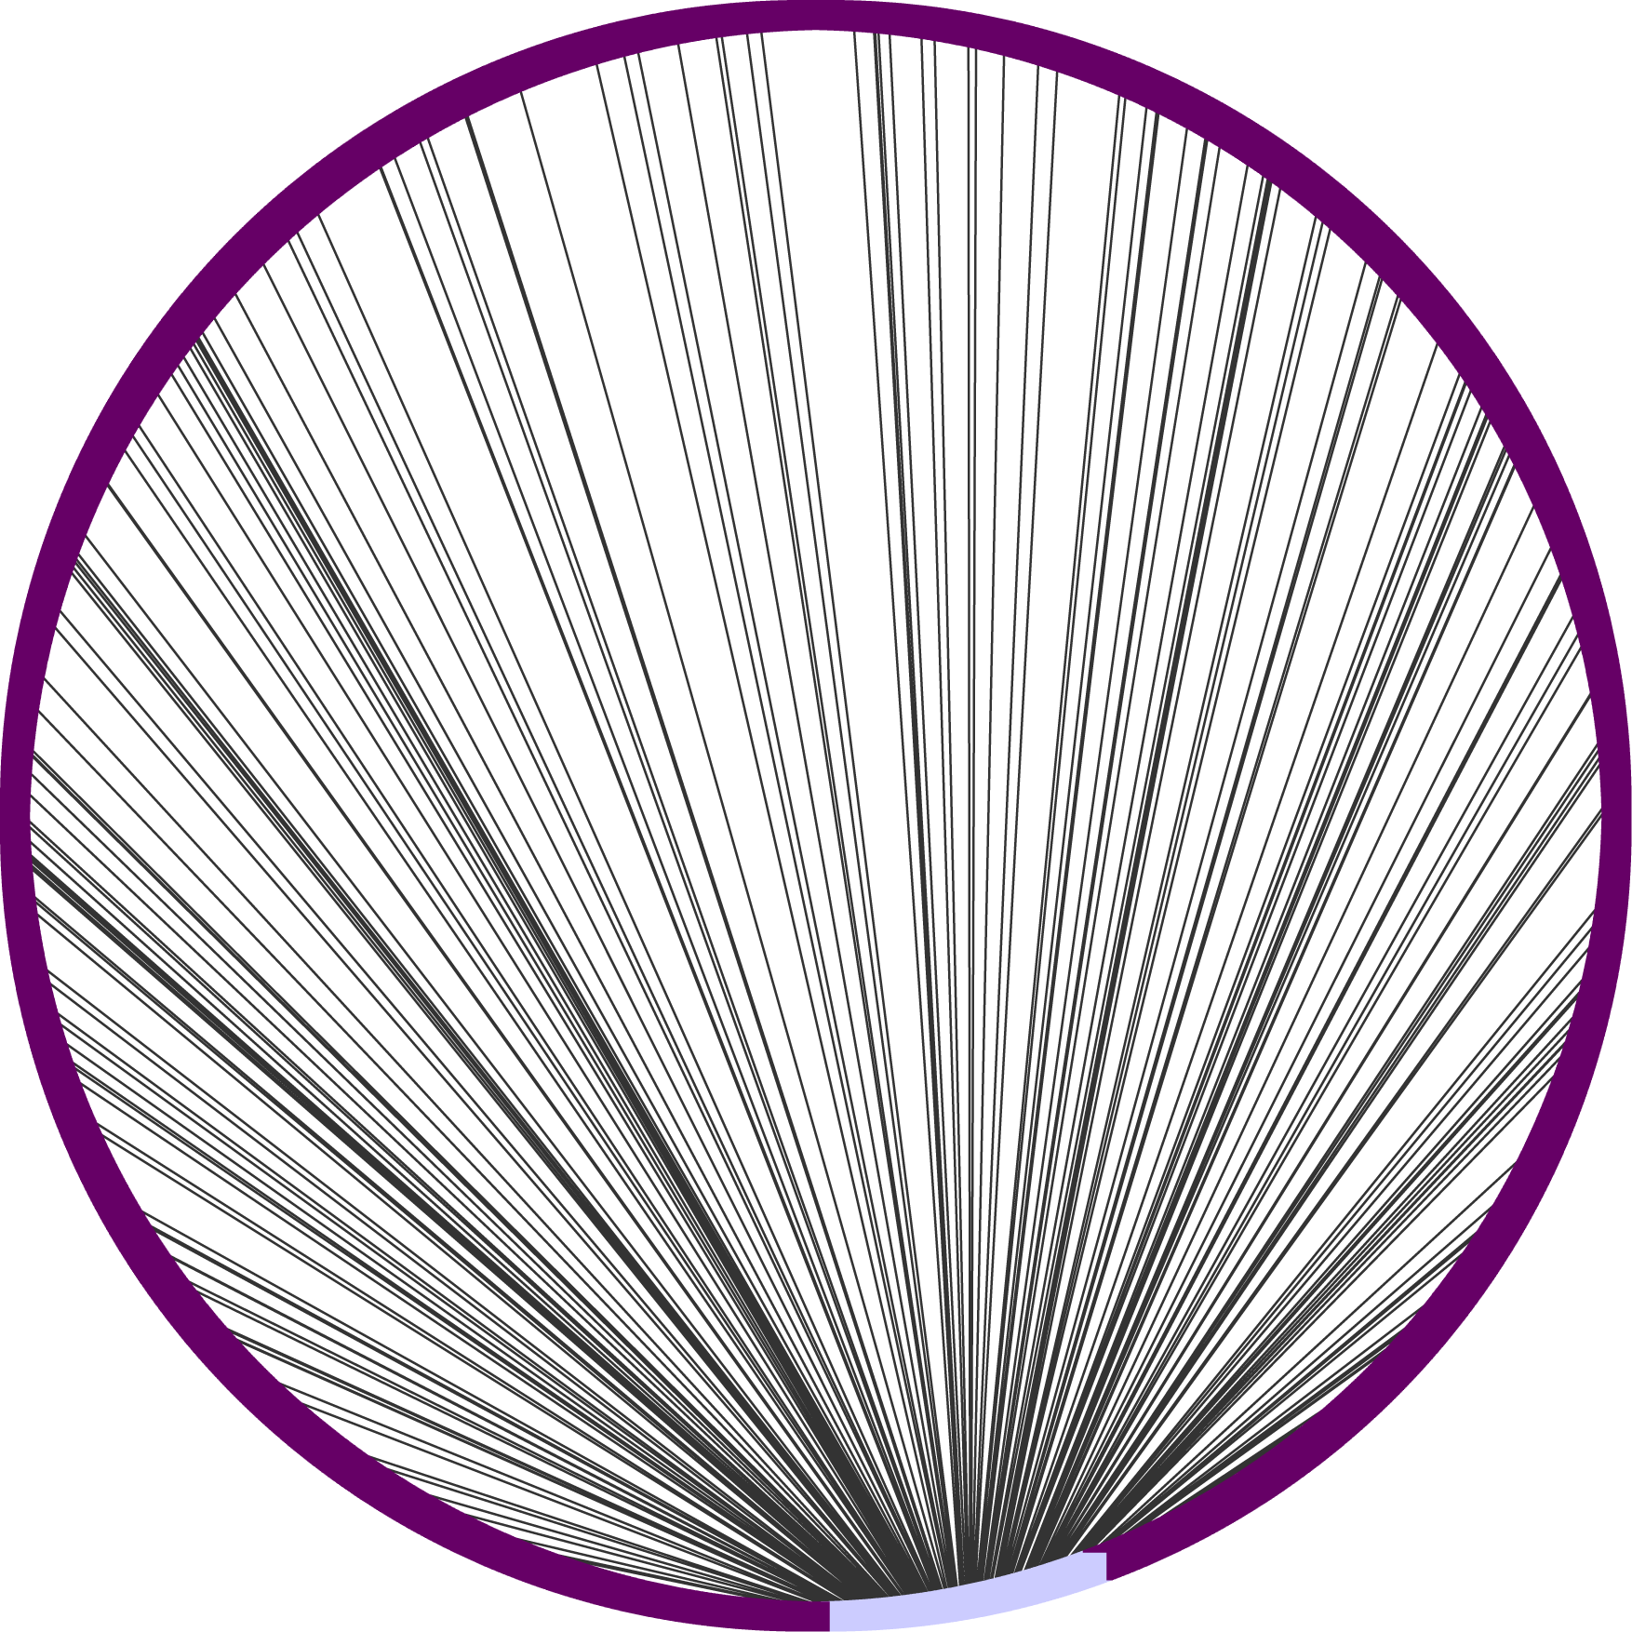
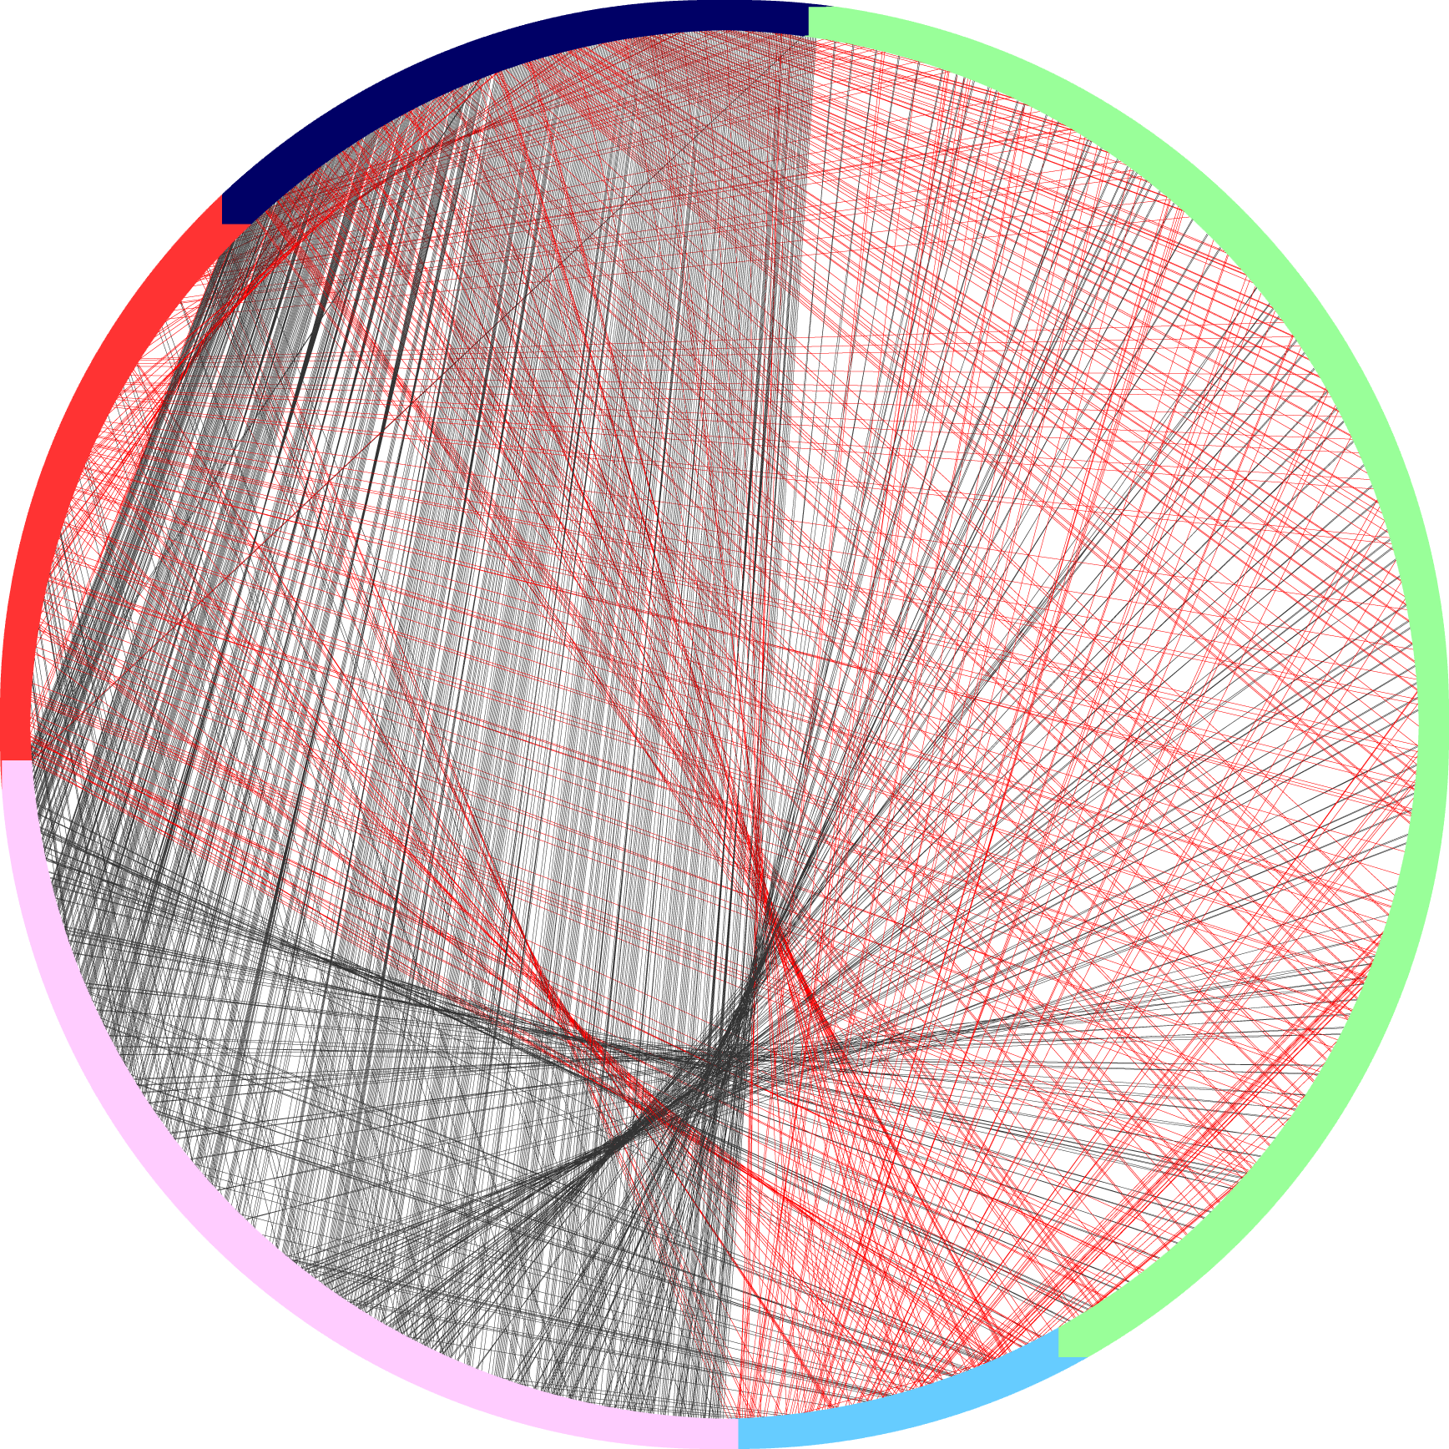
Sources Of Experimental Function Annotation In UniProt-GOA, Implications For Function Prediction
Alexandra M Schnoes¹, Alexander Thorman², Iddo Friedberg^{2,3}
Dept of Bioengineering and Therapeutic Sciences, University of California San Francisco, San Francisco, CA 2. Dept. of Microbiology, Miami University, Oxford, OH 3. Dept. of Computer Science and Software Engineering, Miami University, Oxford, OH
Abstract
Computational protein function prediction programs rely upon well-annotated databases for testing and training their algorithms. These databases, in turn, rely upon the work of curators to capture experimental findings from the scientific literature and apply them to protein sequence data. However, due to high-throughput experimental assays, it is possible that a small number of experimental papers could dominate the functional protein annotations collected in databases. Here we investigate just how prevalent is the “few papers – many proteins” bias. We examine the annotation of experimental protein function in the UniProt Gene Ontology Annotation project (GOA), analyzing the set of 50 papers that annotate the most proteins, and find evidence of bias. In particular, we find that for several important model species, a significant fraction of the annotations available are provided by only a few dominant papers. Given that most high-throughput techniques can find only one (or a small group) of functions, it appears that some level of experimental protein function annotation bias is unavoidable. We discuss how this bias affects our view of the protein function universe, and consequently our ability to predict protein function. Knowing that this bias exists and understanding its extent is important for database curators, developers of function annotation programs, and anyone who uses protein function annotation data to plan experiments.
Experimental Annotation Coverage in GOA
Are the same proteins annotated repeatedly?
A. thaliana
C. elegans
D. melanogaster
Human
Top 50 papers provide greater than 10% annotation coverage for 6 out of 9 species. Nine species were represented in the top 50 papers that annotated the most proteins. The percent annotation coverage is calculated as the fraction of annotations in the top 50 papers relative to all experimental annotations available for that species in GOA.
Mouse
M. tuberculosis
UniProt-GOAª Statistics
Count of experimental evidence codes in GOA.
Experimental Evidence Codes in GOA | Count
All | 522,208
IEP (Inferred from Expression Pattern) | 13,972
IPI (Inferred from Physical Interaction) | 63,832
IMP (Inferred from Mutant Phenotype) | 184,084
EXP (Inferred from Experiment) | 31
IGI (Inferred from Genetic Interaction) | 26,522
IDA (Inferred from Direct Assay) | 233,767
S. pombe
Different Ontology
S. cerevisiae
Same Ontology
Visualization of between paper sequence identity in each species. Each circle depicts the collection of papers from each species in the top 50 papers (no. of papers > 1). Each paper is designated by an arbitrary color and painted on the circumference of a circle. The arc of any one color on the circumference is directly proportional to how many sequences were annotated in that particular paper. A line is drawn between any two papers when a sequence in one paper is sequence identical to a sequence in the other paper. The color of the line indicates whether this sequence identity occurs between sequences that are annotated in the same ontology (red line) or different ontology (black line).
Count of all experimental annotations in each ontology in GOA.
Certain individual papers can increase annotation coverage in a species by over 5%. Species depicted are those represented in the Top 50 papers. Abbreviations: TB (Mycobacterium tuberculosis), Pombe (Schizosaccharomyces pombe), Arabidopsis (Arabidopsis thaliana), Dicty (Dictyostelium discoideum), Cerevisiae (Saccharomyces cerevisiae), Elegans (Caenorhabditis elegans), Drosophila (Drosophila melanogaster).
An analysis of sequence redundancy in the top 50 papers shows that the majority of examined species exhibit redundancy levels above 30% (highlighted).
Species | Total Sequences | No. Clusters 100% Seq ID | Percent Redundant | No. Clusters 97% Seq ID | Percent Redundant | No. Clusters 95% Seq ID | Percent Redundant
A. thalliana | 8879 | 4694 | 47% | 4640 | 48% | 4595 | 48%
C. elegans | 8416 | 3338 | 60% | 3296 | 61% | 3292 | 61%
D. melanogaster | 1217 | 1003 | 18% | 787 | 35% | 767 | 37%
Human | 5593 | 4509 | 19% | 3889 | 30% | 3748 | 33%
M. tuberculosis | 2351 | 1702 | 28% | 1700 | 28% | 1700 | 28%
Mouse | 4220 | 2273 | 46% | 1907 | 55% | 1813 | 57%
S. cerevisiae | 3542 | 2550 | 28% | 2547 | 28% | 2546 | 28%
S. pombe | 4502 | 4281 | 5% | 4262 | 5% | 4253 | 6%
UniProt-GoA version: Dec 2011, ftp://ftp.ebi.ac.uk/pub/databases/GO/goa/
a
Top 25 Papers—
The Set of Papers that Annotate the Most Proteins in GOA
Annotation Trends for the Top 50 Papers in GOA
Clustering performed by CD-Hit, http://weizhong-lab.ucsd.edu/cd-hit/
Listing of the 25 papers in GOA that annotate the most proteins.
S. cerevisiae
a
Conclusions
S. pombe
Experimental annotation bias in GOA exists: Individual papers can account for a significant number of the available annotations in GOA. This effect is species dependent.
Certain annotations are more populated in high-throughput experimental papers.
High-throughput methods have a tendency to annotate the same proteins. In some cases, complimentary experiments have been done (annotating to different ontologies), however, the papers in our top 50 group overwhelmingly annotate to a large core of identical sequences.
The determined biases have consequences for function prediction:
Because many high-throughput papers annotate the same proteins, increased high-throughput experimentation will likely not increase our ability to ‘see farther’ in function space.
As high-throughput experiments produce only certain ontology terms, function prediction from these papers are limited, even though they produce a large number of experimental annotations.
Certain model species are overwhelmingly annotated by a small number of high-throughput papers. As high-throughput techniques typically include larger margins of error, the accuracy of the majority of experimental annotations for certain model systems could be in question.
M. tuberculosis
Mouse
Human
D. melanogaster
D. discoideum
C. elegans
A. thaliana
Acknowledgements: The UCSF Resource for Biocomputing, Visualization and Informatics (RBVI) for computational resources.
Ontology abbreviations: BPO (Biological Process Ontology), CCO (Cellular Compartment Ontology), MFO (Molecular Function Ontology)
Top 50 papers predominantly annotate to a limited set of GO annotations. Repeated GO terms are highlighted. A species without 5 listed terms did not have 5 or more GO terms associated with it in the top 50 papers. 18/39 listed terms are populated over 30%.
Notes:
CC1229—MU red
79B2B8-ucsf teal
252525—lighter than black
404040—lighter than lighter than black
2. Data on all GOA annotations and species
3. Data on # of annotations per protein
4. Most common terms per species (top 50)
5. Depth vs. commonality

